Slide 1

Introduction to Epistemic Network Analysis
Dr Barbara Dzieciatko-Szendrei
b.dzieciatko@sms.ed.ac.uk

Slide 2

Plan for the workshop
Part1 - LO1: Understand what Epistemic Network Analysis (ENA) is and when to use it.
Break
Part2 - LO2: Learn how to generate qualitative codes and practice segmenting discourse data.
Break
LO3 - Build and interpret simple epistemic network models using the ENA

Slide 3
Ice breaker (10 min):
Please stand up
First, we are going to align ourselves on the line: Stand at either extreme of the line or the middle on how you respond to the following statement:
The meaning of data depends on the stories, conversations, and contexts that shape it.
(Feel free to speak to people in your vicinity)
Now we are going to form another line, stan on one end if you strongly agree to the following:
The world can best understood through patterns that can be measured, modelled, and tested.

Slide 4
LO1: Understand what Epistemic Network Analysis (ENA) is and when to use it.

Slide 5
Back in your seats, discuss (5 min):
What experiences influenced where you placed yourself on each axis? Has your position changed after hearing others’ experiences?
Were you clustered with people similar to you, or different?
Did you hear any shared challenges or patterns across roles and institutions? What was it?
Report back

Slide 6
Quantitative Ethnography (QE) as the Theoretical Core of ENA
Ethnography – a method of studying culture, social behaviour and practices
Ethnographic methods give deep insight but are small-scale (“thick but narrow”).
Quantitative techniques handle large samples to make inferences about a population but miss context (“shallow but broad”).
QE ensures compatibility between big-data analytic and interpretive ethnography without violating the assumptions of either

Slide 7
What is Epistemic Network Analysis (ENA)
ENA is a network-based method for analysing codified data
Developed by Professor Shaffer and his team at the University of Wisconsin-Madison (UWM)
Today we will learn:
How to code qualitative data with the methods from QE
How to segment qualitative data to make it compatible for ENA
How to code with automated codifier (nCoder)
How to build simple models and interpret ENA Graphs
There is a web interface and R package (links in your GitHub Repo)
International Society for Quantitative Ethnography: https://www.qesoc.org/

Slide 8
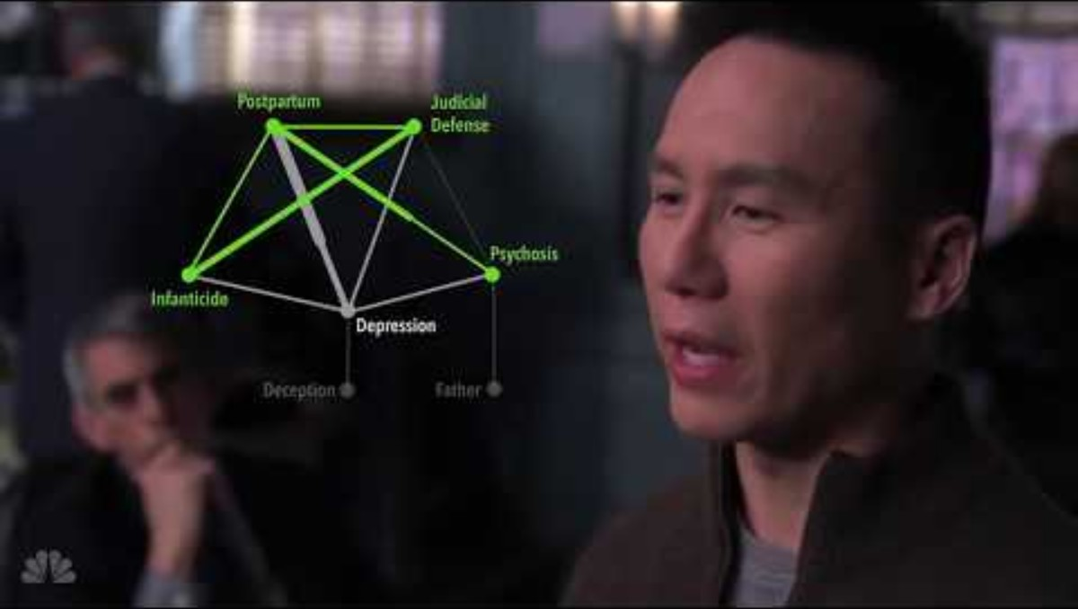
What is Epistemic Network Analysis (ENA)
ENA is a network-based method for analysing codified data = we explore how Codes relate to each other to reveal patterns of thinking
LO1: Understand what Epistemic Network Analysis (ENA) is and when to use it.
Notes:
Developed by Professor David Shaffer from the University of Wisconsin Madison and his lab to study problem solving in simulated apprenticeships

Slide 9

Key Concepts in ENA
Utterance: The smallest segment of discourse (e.g. a sentence; a line).
Stanza(Conversation): Units in which we measure code co-occurrences.
Codes: A set of concepts whose interactions we want to understand. Each code can stand for idea, skill, value or any epistemic element
Unit of analysis: Objects for which we want to understand interactions between codes (individual people, subgroups etc.).
LO1: Understand what Epistemic Network Analysis (ENA) is and when to use it.

Slide 10
How ENA is used
Understand how ideas connect (Peters-Burton et al., 2022)
Analyse complex thinking and cognitive structures (Csanadi et al., 2018; Li et al., 2022)
Compare groups, perspectives, or expertise levels (Fan et al., 2023; Peters-Burton et al., 2023; Dzieciatko-Szendrei & Pantić, in press)
Transform qualitative data into analysable networks (Bressler et al., 2019; Chang & Tsai, 2023)
Analysing curriculum/standards alignment (Cheung, 2020; Gao et al., 2023)
Study change, development, or trajectories (Mulvey et al., 2021; Pantić et al. 2022)

Slide 11
Knowledge check:
Match concepts and descriptions:
Concept | Description
ENA | The smallest segment of discourse coded for meaning.
Quantitative Ethnography | A set of concepts whose interactions we want to understand.
Code | A broader framework combining qualitative and quantitative approaches to make meaning measurable.
Utterance | A method that models connections among ideas in discourse to understand patterns of thinking.

Slide 12
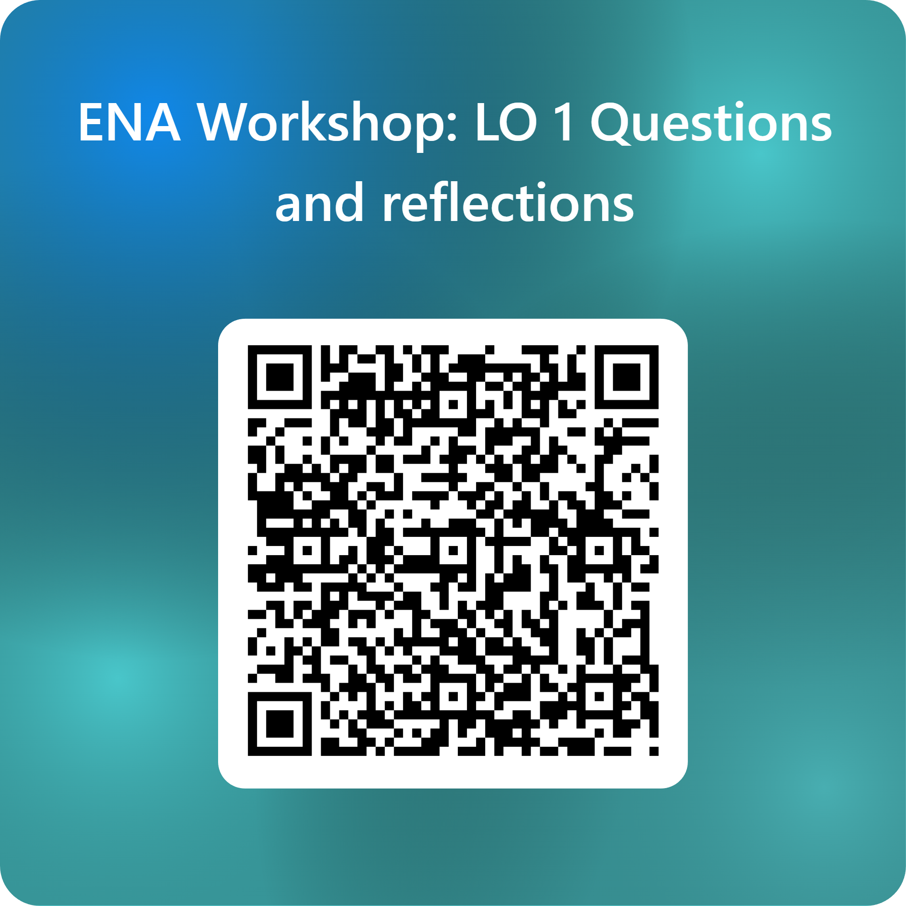

5 min Break
Write or think individually if you have any questions or reflections so far and submit them here (scan the QR Code):

Slide 13

LO2: Learn how to generate qualitative codes and practice segmenting discourse data.

Slide 14
Ethnography
James Paul Gee, An Introduction to Discourse Analysis: Theory and Method (4th ed.), 2014
discourse (small d) = the actual language part of that enactment (e.g. conversation)
Discourse (Big D) = language plus actions, values, tools, and identities that enact a particular social role or community membership.
LO1: Understand what Epistemic Network Analysis (ENA) is and when to use it

Slide 15

In ENA terms:
Coding and modelling the small “d” discourse helps us infer the Big “D”
Discourse = how people are thinking and acting as, members of a subgroup (e.g. gamers, teachers, engineers, scientists etc.)
Shaffer (2017) makes a distinction between “code” with a small “c” and Code with a capital “C”

Slide 16
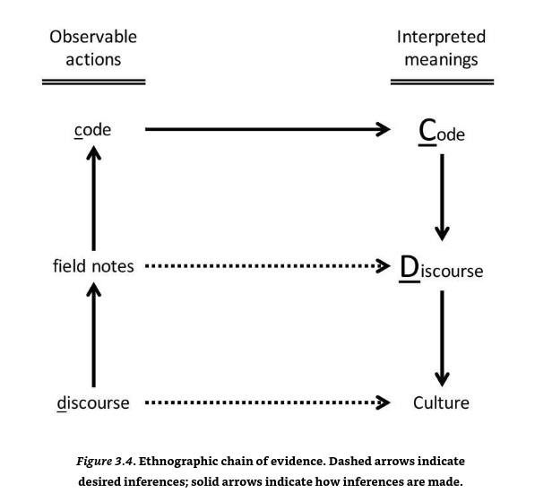
Coding qualitative data
Big-C Code: A culturally meaningful idea within a Discourse. (Identity, values, practices, knowledge, norms, etc.)
Small –c codes: Observable actions or statements expressed by individuals or groups that are used as empirical indicators of broader conceptual Codes.
Shaffer, 2017

Slide 17
Example
Data excerpt (small-d discourse):
“No one should graduate from J-school without knowing how to file a Freedom of Information request. It’s a fundamental investigative tool.”
codes (small-c):
Mentions specific reporting procedures
Frames FOIA as essential skill
Uses normative language (“should”)
Possible Codes (Big-C):
Investigative practices
Professional knowledge
Values of good reporting

Slide 18
How we find Codes
Read data repeatedly
Identify and describe things that seem meaningful
Group similar excerpts ( “sort and define”)
Refine definitions
Check examples
Iterate until saturation (“Lather. Rinse. Repeat.”)
Distinguish Big-C Codes form small codes
Document everything in a codebook

Slide 19
What Goes in a Codebook
Minimum elements:
Code name
Code definition – the meaning
Examples – discourse evidence
Optional (but useful for ENA):
Inclusion/exclusion criteria
Links to theory
Synonyms/related codes

Slide 20
Group Task: Coding Book (35 min)
Aim: to develop max 3 qualitative codes
Download files from GitHub rep
Open CodingExercise.csv
Look at the sample data dialogue
Start with descriptions, what are the characters talking about
Develop max 3 codes with a definition and example
Present what codes you have developed, explain your process
LO2: Learn how to generate qualitative codes and practice segmenting discourse data.

Slide 21
15 min Break
Write or think individually if you have any questions or reflections so far and submit them here (scan the QR Code):

Slide 22
Data Segmentation
Data Already Has Structure — We Just Need to See It (Shaffer, 2017).
Segmentation is dividing discourse into parts
For ENA, segmentation is not an optional step. It is foundational.
The unit of segmentation determines:
which codes co-occur,
which connections ENA will consider meaningful, and
how the network ultimately represents reasoning or discourse.
If we segment poorly, ENA will visualise noise. If we segment thoughtfully, ENA reveals meaningful patterns in thinking and interaction.

Slide 23
When segmenting the data we consider:
Smallest meaningful unit of the discourse (a line, paragraph?)
Consistency – the segmentation needs to occur consistently (e.g. a line per person, end of an idea)
Temporal context: The data ideally needs to be sorted into temporal sequence
Boundaries: Which connections should NOT be made
Stanza: Units in which we measure code co-occurrences. In a dialogue how many lines back an utterance relates to (5 on average)? how far is an idea or concept related in time to original concept?
Metadata: labels or descriptors that tell you the extra information surrounding the utterance that makes the utterance meaningful in ENA.
Notes:
Stanza – a set of lines in a single conversation that are within the same relevant context ad therefore related to one another

Slide 24
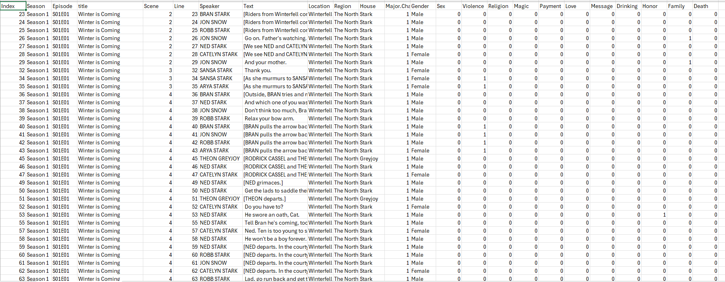
Meta Data
Notice the data structure on the left side of the table. Metadata is needed to examine:
which utterances belong to which person
which utterances are in the same conversation
which units belong to which comparison group
which networks to compare

Slide 25
Stanza task (15 min)
Moving Stanza Window: ENA uses a sliding segment of consecutive utterances that defines how far back in the conversation ENA looks to determine which codes are considered connected per person or per group. Moving Stanza Windows can be adjusted by the researcher.
You will work in small groups to transform a short conversation into ENA-ready data. Your goal is to:
Identify “link-backs” (which turn of talk are connected to the “referent”)
We will use a moving stanza window of 2
Explain how you made those connections
Report Back
LO2: Learn how to generate qualitative codes and practice segmenting discourse data.

Slide 26
Turn | Speaker | Utterance
1 | Alice | I think our lesson should start with a short warm-up discussion about last week’s topic.
2 | Ben | Good idea. Maybe students can share what they found most challenging.
3 | Carla | Yes, but we need to give them prompts so they don’t go off topic.
4 | Alice | I agree—structured prompts worked well last time.
5 | Ben | Should we split them into small groups or keep it whole-class?
6 | Carla | Small groups usually create more engagement and equal participation.
7 | Alice | True, but whole-class helps us keep track of misconceptions.
8 | Ben | How about we start whole-class and then move to groups?
9 | Carla | That sounds balanced. Let’s draft the prompts next.
LO2: Learn how to generate qualitative codes and practice segmenting discourse data.

Slide 27

Introduction to nCoder
https://www.n-coder.org/
develop, validate, and implement automated classifiers for large data
nCoder presentation:
Uploading Data
Creating Classifiers
LO2: Learn how to generate qualitative codes and practice segmenting discourse data.
Notes:
a

Slide 28
nCoder Task
For nCoder go to https://app.n-coder.org/
Let’s upload uncoded GoT Data GOT.scripts.code.exerciseS1ep1to3.csv
Open Code Book GoT_codebook.xlsx
Load the data to nCoder
Develop code classifiers
Validate codes
Train the data
LO2: Learn how to generate qualitative codes and practice segmenting discourse data.

Slide 29
10 min Break
Write or think individually if you have any questions or reflections so far and submit them here (scan the QR Code):

Slide 30
LO3: Build and interpret simple epistemic network models using the ENA

Slide 31

Epistemic Network Analysis
In network studies we distinguish nodes and edges
Nodes represent “entities”
Edges represent relation between entities
In ENA Terms, our entities are Codes and edges represent co-occurrences between Codes in a unit of analysis

Slide 32
Networks and adjacency matrix
Networks study relations e.g.:
A →B and B→A
A→C but C ≠ B or A
These can be described as matrix:
Or a plot:
 | A | B | C
A | 0 | 1 | 1
B | 1 | 0 | 0
C | 0 | 0 | 0
A
B
C

Slide 33
Answer:
Turn | Speaker | What It Links Back To | Explanation
1 | Alice | — | Starts new topic
2 | Ben | 1 | Builds on Alice’s warm-up idea
3 | Carla | 1, 2 | Responds to discussion about warm-up & challenges
4 | Alice | 3 | Responds to Carla about structured prompts
5 | Ben | 1, 4 | Shifts back to activity structure & control
6 | Carla | 5 | Responds to group vs whole-class
7 | Alice | 6, 5 | Negotiates format based on engagement & control
8 | Ben | 5, 7 | Blends earlier proposals (whole-class + small groups)
9 | Carla | 8 | Agrees and moves to next task

Slide 34
Or we could express it as:
Turn → / Links Back To ↓ | 1 | 2 | 3 | 4 | 5 | 6 | 7 | 8 | 9
1 | 0 | 0 | 0 | 0 | 0 | 0 | 0 | 0 | 0
2 | 1 | 0 | 0 | 0 | 0 | 0 | 0 | 0 | 0
3 | 1 | 1 | 0 | 0 | 0 | 0 | 0 | 0 | 0
4 | 0 | 0 | 1 | 0 | 0 | 0 | 0 | 0 | 0
5 | 1 | 0 | 0 | 1 | 0 | 0 | 0 | 0 | 0
6 | 0 | 0 | 0 | 0 | 1 | 0 | 0 | 0 | 0
7 | 0 | 0 | 0 | 0 | 1 | 1 | 0 | 0 | 0
8 | 0 | 0 | 0 | 0 | 1 | 0 | 1 | 0 | 1
9 | 0 | 0 | 0 | 0 | 0 | 0 | 0 | 1 | 0

Slide 35
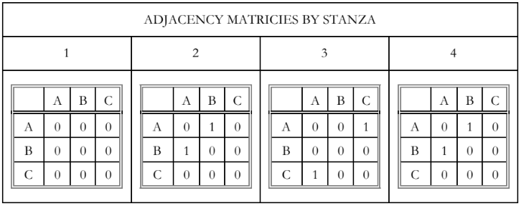
ENA Matrix
Turn | Person | Utterance | Evidence/reference | Relation | Work ethic | Skills
1 | A | The best student are those who always do their homework. | “student behaviour” “homework” | n/a | 1 | 0
2 | B | I agree with that, but I think student should also think critically | “I agree with…” | Agreement between B and A | 1 | 1
3 | C | I agree work ethic is a good indicator of a good student | “I agree work ethic is…” | Agreement between C and A | 1 | 0
4 | B | Although, homework can develop those skills | “homework” | Agreement between B and A | 1 | 1
ENA creates matrixes of code co-occurrences in conversations, per stanza
However, the ties are not directed (assumption)
LO3: Build and interpret simple epistemic network models using the ENA

Slide 36
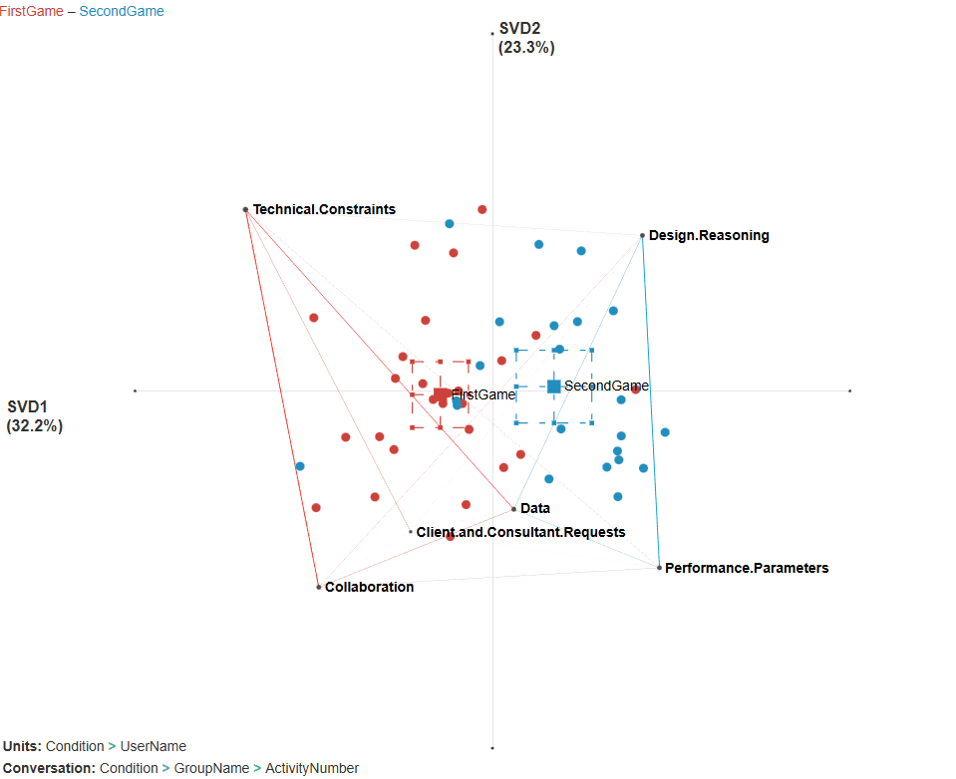






Interpreting ENA Plots
1. Rotation dimensions and variance.
2. Code.
3. Tie.
4. Centroid.
5. Confidence Intervals
6. Plot Points (Players)
Notes:
1. Dimensions. SVD1 and SVD2 are indicators of how the network was rotated in two-dimensional space. This usually is done to improve the visibility of the codes and ties. Additionally, codes can be projected on a circle to improve visibility. The circle method is a preferred mode used throughout this study. ENA rotates the space using singular value decomposition which oves the space to where there is most variance in the data, that is to highlight biggest differences between people or groups.
2. Code. The nodes in the network are the Codes identified by the researcher. The number of Codes depends on the research questions and decisions of the researcher. ENA tends to position codes in a space where these connections are characteristic of the comparative participant groups or themes. In this instance, comparison&reflection, parental_involvement, emotional_support etc. congregate towards the left of the network, while teaching_practice, student_learning&behaviour, resource_sharing&use etc. congregate to the right.
3.Tie. Codes have a tie with another Code if they co-occur together in the dataset e.g. in a conversation. The thicker the line the more the connection between codes is present. The strength of associations between two codes in an epistemic network is determined by the difference in connection strengths between nodes across two networks. It's important to note that these co-occurrences indicate the frequency with which codes appear together, not causal relationships.
4. Group centroid (mean mass of the network for the group). A centroid represents the aggregate or average position of an epistemic network within a given space, analogous to the centre of the mass of an object (Shaffer, 2017). In other words, it is a single point that represents the collective positionality and associations of codes within the network for particular groups. In this example, threads were made in the school months and the summer. The location of a centroid is determined by two factors: 1) positionality of codes where codes are situated within the network, which in turn depends on the relationships (associations) between them; and 2) strength of associations which is how strongly codes are connected. This means that the further the centroids are from each other, the greater the differences between groups.
5. Confidence intervals. ENA calculates confidence intervals for each of the groups and plots them with the centroids. Smaller confidence intervals indicate that the difference between groups is less likely to be by chance. In this case, confidence intervals are very small. This visual assessment provides an intuitive method to gauge differences between groups or conditions within the data. Small confidence intervals indicate a high degree of precision in the estimated location of the centroid within the network space. This means that there is less variability in the positioning of codes and their associations for the unit or group being analysed suggesting a more consistent pattern of connections among the codes.
6. Plot points. ENA calculates a network of co-occurrences for each case. In this example, one point represents one thread made in the summer or the school months. Plot points allow visualisation of the distribution of each case in the two-dimensional space, but usually, this is hidden for better visibility. The plot point concentration corresponds to the position of a centroid.

Slide 37
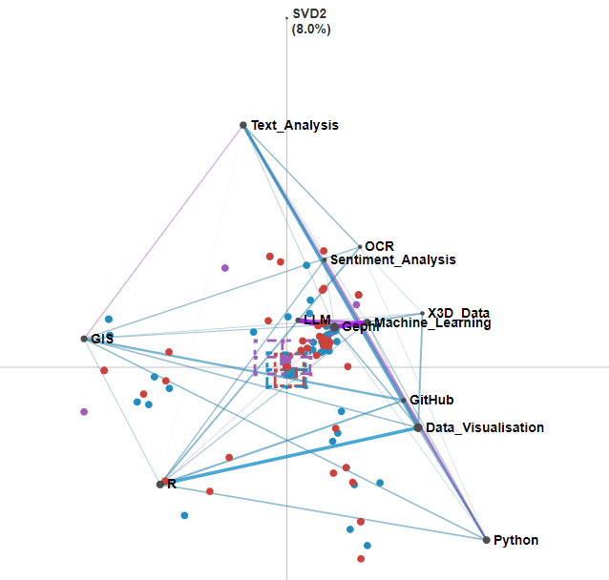
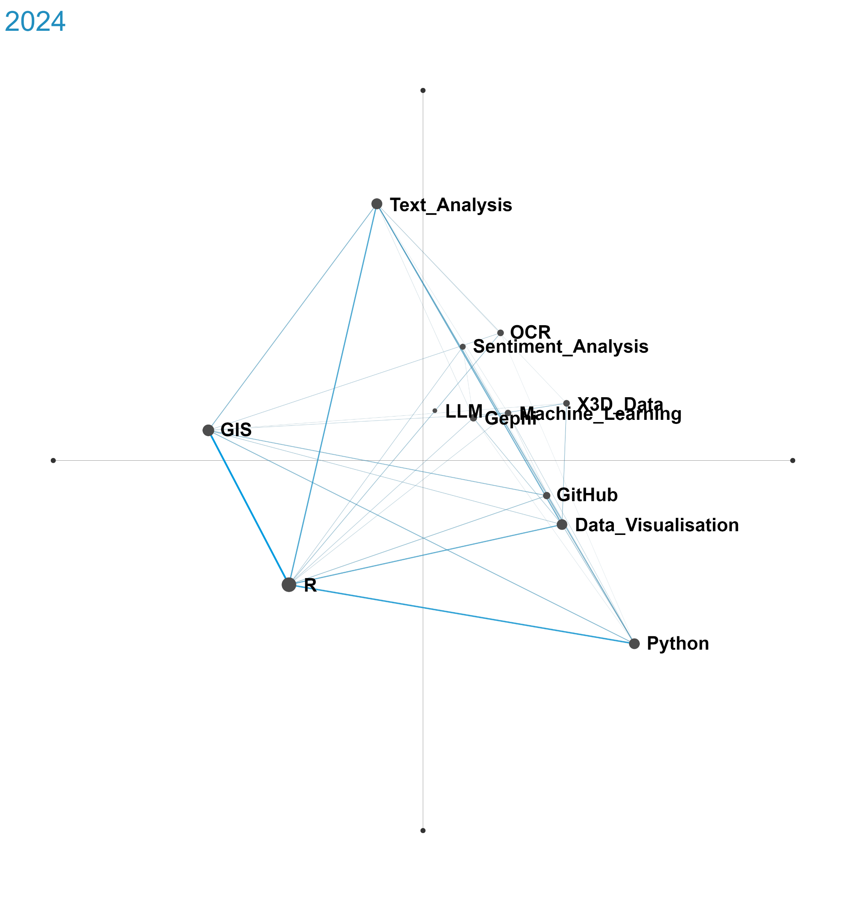
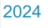
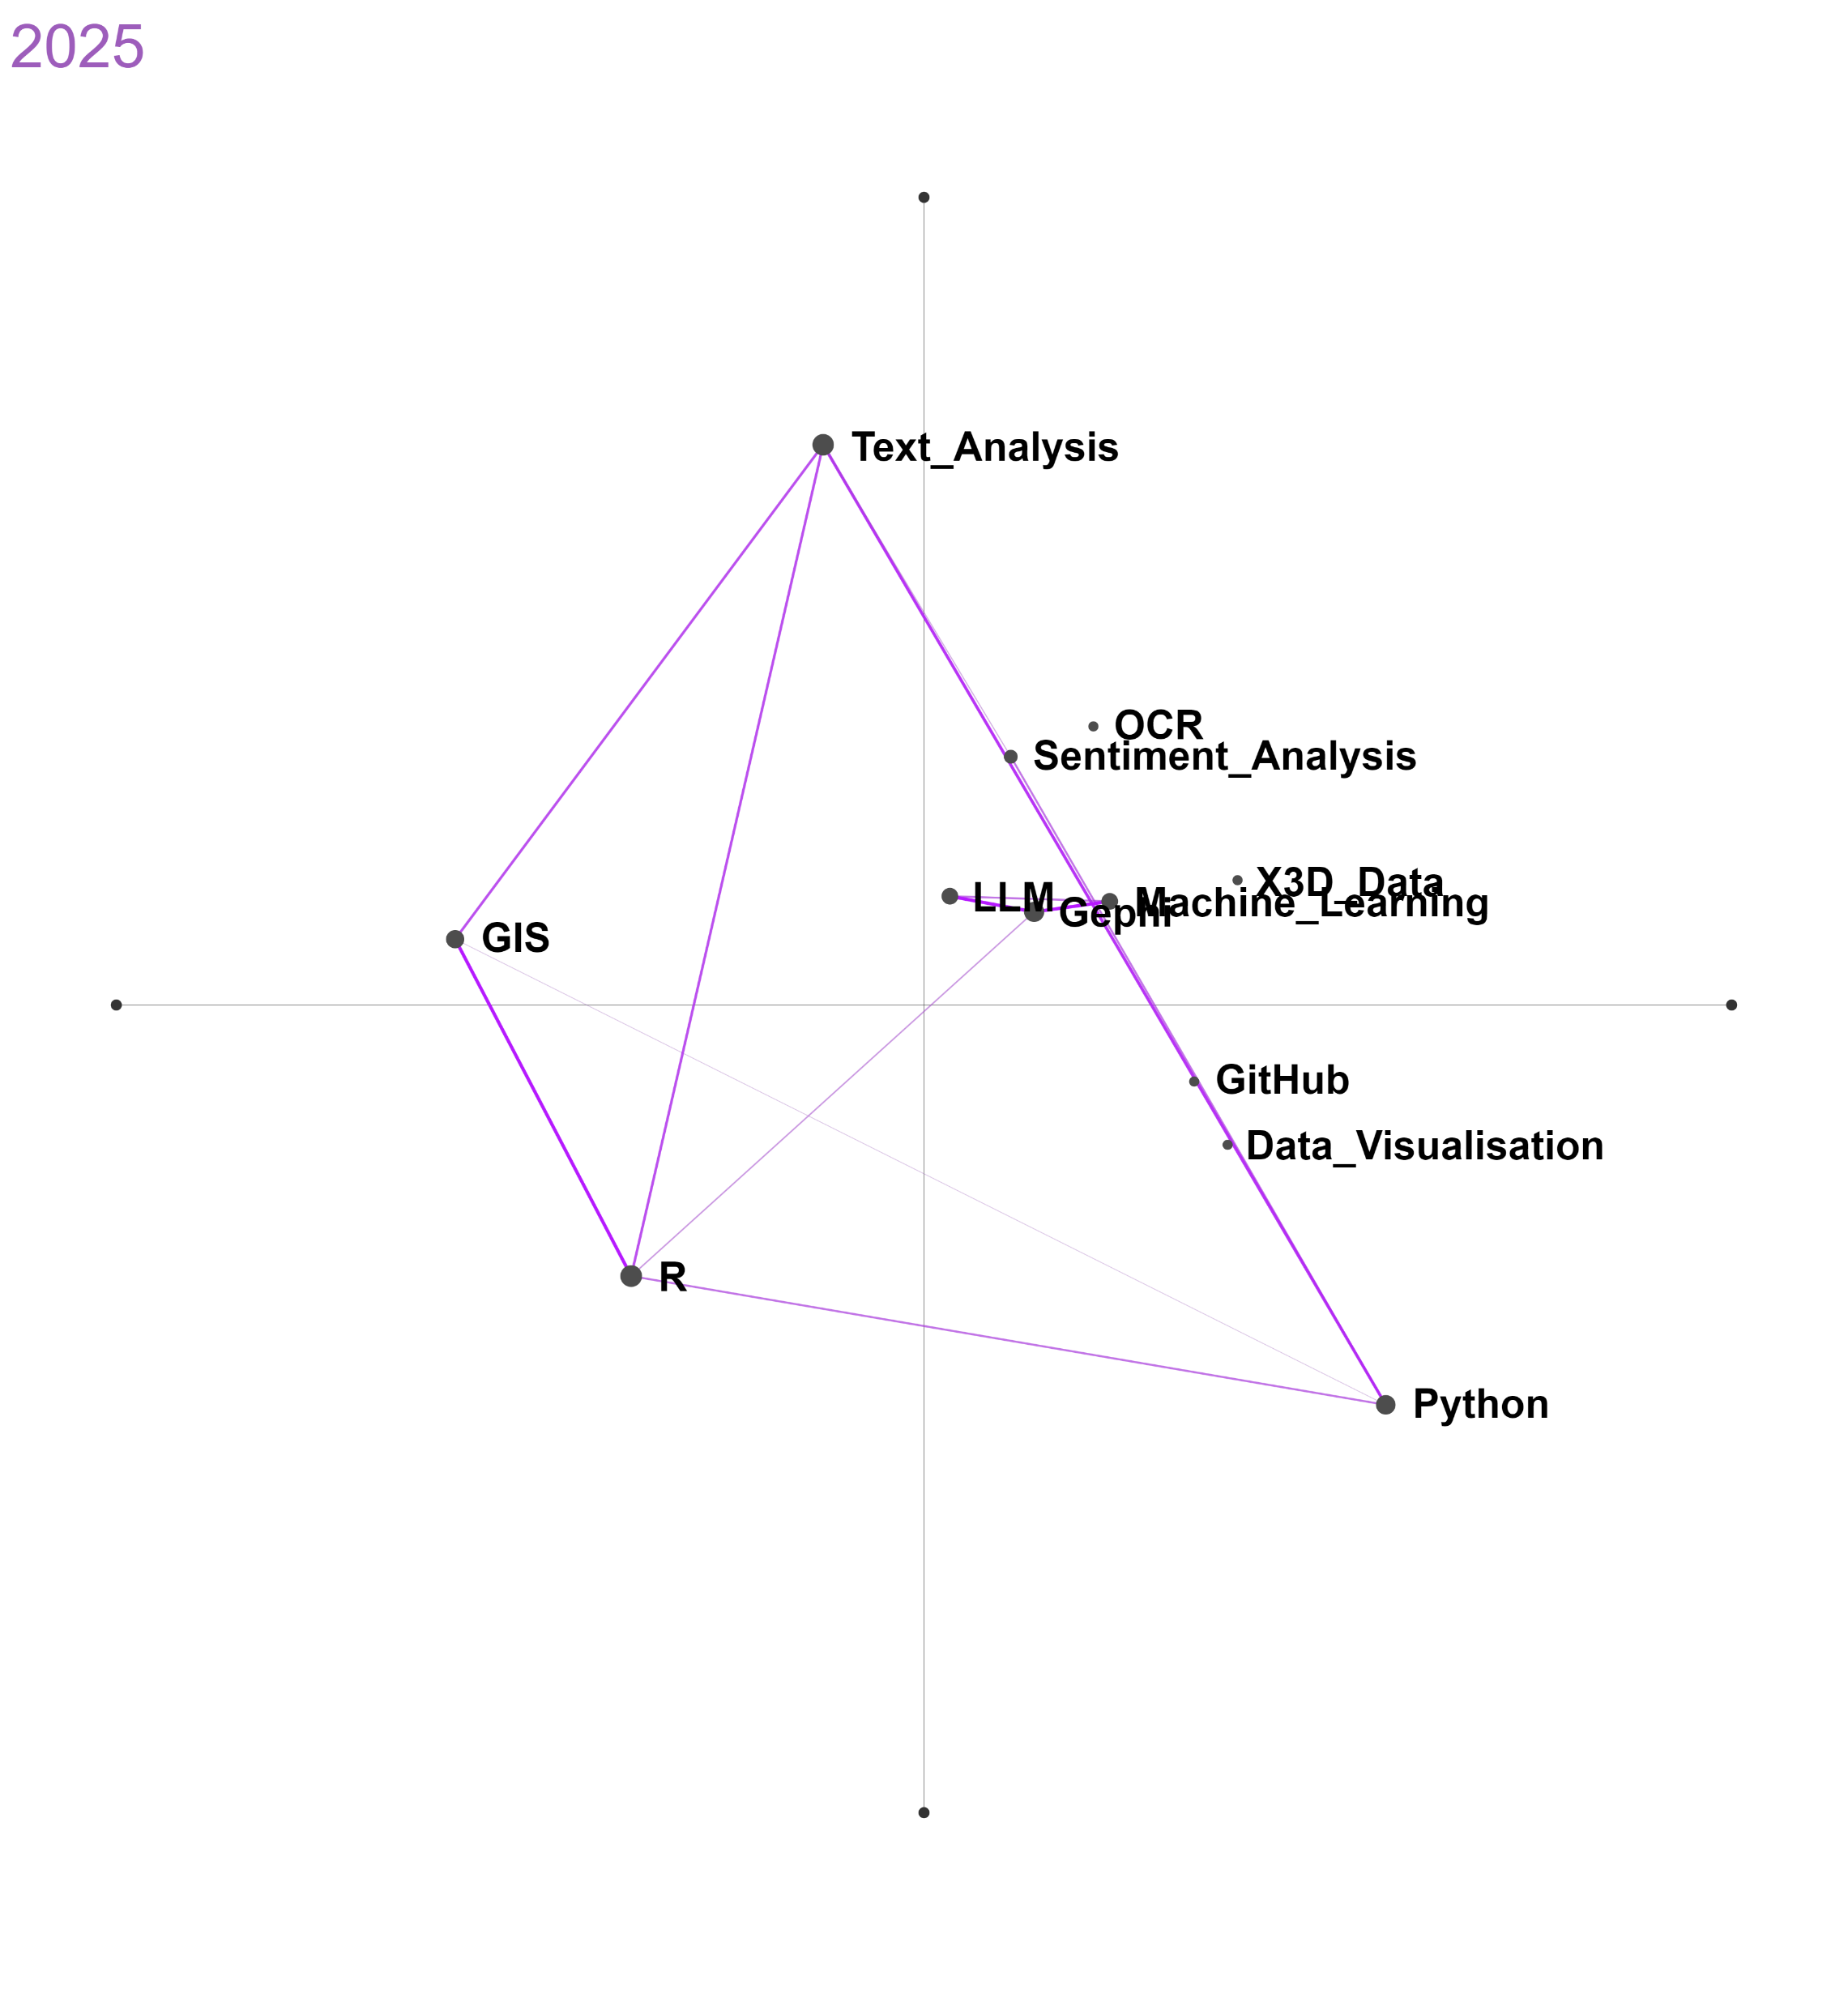
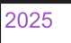
3 types of Plots
Comparison Plot
Subgroup Plots
Epistemic Network Analysis of themes from CDCS course titles (2023–2025). Squares summarise year-level thematic clustering. The 2025 cluster (purple) is distinct from 23 (red)& 2024 (blue).

Slide 38
Presentation of the ENA Tool
Go to https://app.epistemicnetwork.org/login.html
Upload GoT Data
Step by step model set up
Play with settings
You want to investigate the following
How are the dialogues different between male and female characters?
What are the differences in the dialogues between E1 and E3?
What are differences in discourse between your select houses?
LO3: Build and interpret simple epistemic network models using the ENA

Slide 39
References
Bressler, D. M., Bodzin, A. M., Eagan, B., & Tabatabai, S. (2019). Using epistemic network analysis to examine discourse and scientific practice during a collaborative game. Journal of Science Education and Technology, 28, 553–566. https://doi.org/10.1007/s10956-019-09771-2
Chang, H. Y., & Tsai, C. C. (2023). Epistemic network analysis of students’ drawings to investigate their conceptions of science learning with technology. Journal of Science Education and Technology, 32(2), 267–283. https://doi.org/10.1007/s10956-022-10026-1
Cheung, K. K. C. (2020). Exploring the inclusion of nature of science in biology curriculum and high-stakes assessments in Hong Kong: Epistemic network analysis. Science & Education, 29(3), 491–512. https://doi.org/10.1007/s11191-020-00106-z
Csanadi, A., Eagan, B., Kollar, I., Shaffer, D. W., & Fischer, F. (2018). When coding-and-counting is not enough: Using epistemic network analysis (ENA) to analyze verbal data in CSCL research. International Journal of Computer-Supported Collaborative Learning, 13, 419–438. https://doi.org/10.1007/s11412-018-9282-1
Dzieciatko-Szendrei, B., & Pantić, N. (in press). Agency in networks: Understanding teacher participation in an Online Community of Practice with social and epistemic network analysis. Teaching and Teacher Education.
Fan, Y. K., Barany, A., & Foster, A. (2023). Possible future selves in STEM: An epistemic network analysis of identity exploration in minoritized students and alumni. International Journal of STEM Education, 10(1), 22. https://doi.org/10.1186/s40594-023-00440-4
Gao, Q., Cao, Y., Xie, H., & Li, X. (2023). Investigating the nature of science in reformed Chinese biology curriculum standards: Epistemic network analysis. Science & Education, 32, 1–29. https://doi.org/10.1007/s11191-023-00348-w
Gee, J. P. (2014) An Introduction to Discourse Analysis: Theory and Method. Routledge.
Li, S., Huang, X., Wang, T., Pan, Z., & Lajoie, S. P. (2022). Examining the interplay between self-regulated learning activities and types of knowledge within a computer-simulated environment. Journal of Learning Analytics, 9(3), 152–168. https://doi.org/10.18608/jla.2022.742
Mulvey, B. K., Parrish, J. C., Reid, J. W., Papa, J., & Peters-Burton, E. E. (2021). Making connections: Using individual epistemic network analysis to extend the value of nature of science assessment. Science & Education, 30(3), 527–555. https://doi.org/10.1007/s11191-020-00171-4
Pantić, N., Galey, S., Florian, L., Joksimović, S., Viry, G., Gašević, D., Knutes Nyqvist, H., & Kyritsi, K. (2022). Making sense of teacher agency for change with social and epistemic network analysis. Journal of Educational Change, 23(1), 145–177. https://doi.org/10.1007/s10833-021-09413-7.
Peters-Burton, E. E., Dagher, Z. R., & Erduran, S. (2023). Student, teacher, and scientist views of the scientific enterprise: An epistemic network re-analysis. International Journal of Science and Mathematics Education, 21(2), 347–375. https://doi.org/10.1007/s10763-022-10256-7
Shaffer, D. W. (2017). Quantitative ethnography. Madison, WI: Cathcart Press.

Slide 40
Resources
Quantitative Ethnography: Quick Summary
A guide to data preparation

